Slide 1
How To Design Programs

Slide 2
3.1 Designing Functions

Slide 3
3.2 Finger Exercise

Slide 4
Exercise 33
Design the function string-rest, which produces a string like the given one with the first character removed.

Slide 5
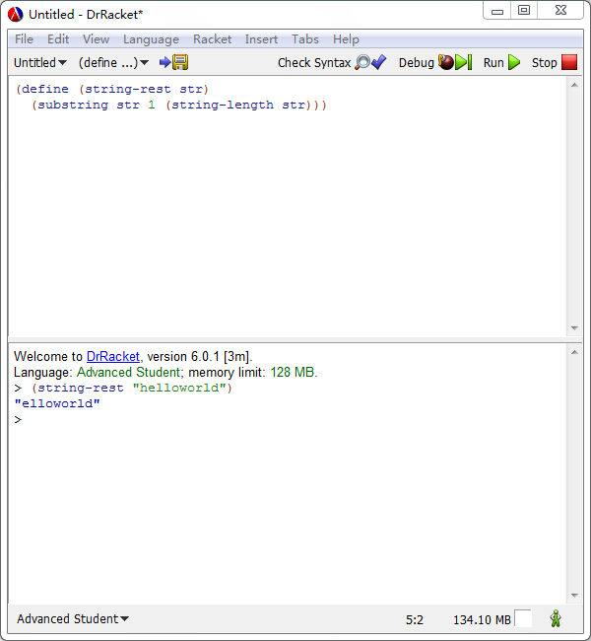

Slide 6
Exercise 34
Design the function string-remove-last, which produces a string like the given one with the last character removed.

Slide 7
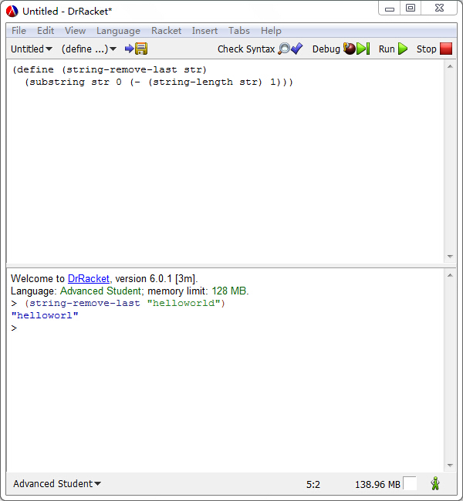

Slide 8
3.3 Domain Knowledge
Domain knowledge is a kind of knowledge that takes to code up the body of a function. Indeed, there are two forms of such domain knowledge.

Slide 9
3.3 Domain Knowledge
Knowledge from external domains such as mathematics, music, biology, civil engineering, art, etc. Because programmers cannot know all of the application domains of computing, they must be prepared to understand the language of a variety of application areas so that they can discuss problems with domain experts. This language is often that of mathematics, but in some cases, the programmers must learn a language as they work through problems with domain experts.

Slide 10
3.3 Domain knowledge
Knowledge about the library functions in the chosen programming language. When your task is to translate a mathematical formula involving the tangent function, you need to know or guess that your chosen language comes with a function

Slide 11
3.4 From Functions to Programs
Not all programs consist of a single function definition. Some require several functions, many also use constant definitions. No matter what, it is always important to design each function of a program systematically, though both global constants and the presence of auxiliary functions change the design process a bit.

Slide 12
3.4 From functions to programs
Multi-function programs come about because interactive programs automatically need event handling functions, state rendering functions, and possibly more. Even batch programs may require several different functions because they perform several separate tasks. Sometimes the problem statement itself suggests these tasks; other times you will discover the need for auxiliary functions as you are in the middle of designing some function.

Slide 13
Wish list!
Each entry on a wish list should consist of three things: a meaningful name for the function, a signature, and a purpose statement. For the design of a batch program, put the main function on the wish list and start designing it. For the design of an interactive program, you can put the event handlers, the stop-when function, and the scene-rendering function on the list. As long as the list isn’t empty, pick a wish and design the function. If you discover during the design that you need another function, put it on the list. When the list is empty, you are done.

Slide 14
3.5 On Testing
Testing quickly becomes a labor-intensive chore. While it is easy to run tests for small programs in the interactions are, doing so requires a lot of mechanical intricate labor. As programmers grow their systems, they add more and more tests. Soon this labor of testing becomes overwhelming, and programmers become sloppy and neglect testing. At the same time, testing is the first tool for discovering and preventing basic flaws. Sloppy testing quickly leads to buggy functions—that is, functions with hidden problems—and buggy functions retard projects, often in multiple ways.

Slide 15
How to test your programs
Compare the output with your expect-result!!

Slide 16
3.6 Designing World Programs
Worldstate: a data definition of your choice, a collection of data that represents the state of the world
Render: big-bang evaluates (render cw) to obtain image of current world
Clock-tick-handler: for each tick of the clock, big-bang evaluates (clock-tick-handler cw) for current world cw to obtain new world

Slide 17
3.6 Designing World Programs
Key-stroke-handler: for each key stroke, big-bang evaluates (key-stroke-handler cw ke) for current world cw and key stroke ke to obtain new world.
Mouse-event-handler: for each key stroke, big-bang evaluates (mouse-event-handler cw x y me) for current world cw, coordinates x and y, and mouse-event me to obtain new world.
End?: after an event is processed, big-bang evaluates (end? cw) for current world cw to determine whether the program stops.

Slide 18
Sample Problem
Design a program that moves a car across the world canvas, from left to right, at the rate of three pixels per clock tick.

Slide 19
First step
For the purpose of world programs, we distinguish between two kinds of constants:
“Physical” constants describe general attributes of objects in the world, such as the speed or velocity of an object, its color, its height, its width, its radius, and so forth. Of course these constants don’t really refer to physical facts, but many are analogous to physical aspects of the real world.
(define WIDTH-OF-WORLD 200)
(define WHEEL-RADIUS 5)
(define WHEEL-DISTANCE (* WHEEL-RADIUS 5))

Slide 20
Graphical constant
Graphical constants are images of objects in the world. The program composes them into images that represent the complete state of the world.
(define WHEEL (circle WHEEL-RADIUS "solid" "black"))
(define SPACE (rectangle WHEEL-DISTANCE WHEEL-RADIUS ”solid” "white"))
(define BOTH-WHEELs (beside WHEEL SPACE WHEEL))

Slide 21
Second step
Those properties that change over time—in reaction to click ticks, key strokes, or mouse actions—give rise to the current state of the world. Your task is to develop a data representation for all possible states of the world. The development results in a data definition, which comes with a comment that tells readers how to represent world information as data and how to interpret data as information about the world.

Slide 22
Second step
For the running example, it is the car’s distance to the left margin that changes over time. While the distance to the right margin changes, too, it is obvious that we need only one or the other to create an image. A distance is measured in numbers, so the following is an adequate data definition:
; WorldState is a Number
; the number of pixels between the left border and the car

Slide 23
Third step
Once you have a data representation for the state of the world, you need to design a number of functions so that you can form a valid big-bang expression.

Slide 24
Third step
To start with, you need a function that maps any given state into an image so that big-bang can render the sequence of states as images:
render

Slide 25
Third step
Next you need to decide which kind of events should change which aspects of the world state. Depending on your decisions, you need to design some of all of the following three functions:
clock-tick-handler
key-stroke-handler
mouse-event-handler

Slide 26
Third step
Finally, if the problem statement suggests that the program should stop if the world has certain properties, you must design
end?

Slide 27
Wish list
(define (render x)
BACKGROUND)
(define (tock x)
x)

Slide 28
Final step
Finally, you need a main function. Unlike all other functions, amain function for world programs doesn’t demand design. It doesn’t even require testing because its sole reason for existing is that you can launch your world program conveniently from DrRacket’s interaction area.
(define (main ws)
(big-bang ws
[on-tick tock]
[to-draw render]))

Slide 29
Exercise 35
Good programmers ensure that an image such as CAR can be enlarged or reduced via a single change to a constant definition. We started the development of our car image with a single plain definition:
(define WHEEL-RADIUS 5)
The definition of WHEEL-DISTANCE is based on the wheel’s radius. Hence, changing WHEEL-RADIUS from 5 to 10 doubles of the car image. This kind of program organization is dubbed single point of control, and good design employs single point of control as much as possible.
Develop your favorite image of a car so that WHEEL-RADIUS remains the single point of control. Remember to experiment and make sure you can re-size the image easily.

Slide 30
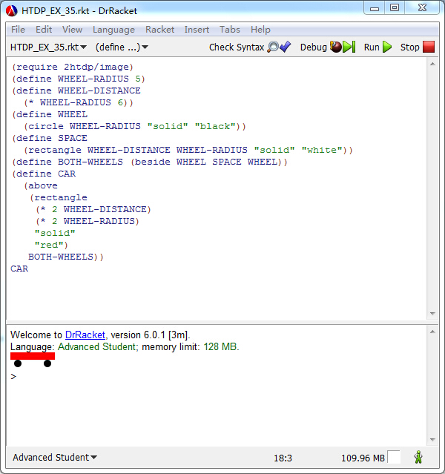

Slide 31
Clock tick
Next we deal with the design of the clock tick handling function on the wish list:
(define (tock ws) ws)
Since the state of the world represents the distance between the left margin of the canvas and the car, and since the car moves at three pixels per clock tick, a concise purpose statement combines these two facts into one.
(define (tock ws)
(+ ws 3))

Slide 32
Render
(define (render ws)
BACKGROUND)
ws =50 (place-image CAR 50 Y-CAR BACKGROUND)
ws =100 (place-image CAR 100 Y-CAR BACKGROUND)
ws =150 (place-image CAR 150 Y-CAR BACKGROUND)
ws =200 (place-image CAR 200 Y-CAR BACKGROUND)

Slide 33
Render
(define (render ws)
(place-image CAR
ws
(image-height CAR)
(empty-scene 400 30)))

Slide 34
Exercise 37
When your program runs to your satisfaction, add a tree to scenery. We used
(define tree
(underlay/xy (circle 10 'solid 'green)
9 15
(rectangle 2 20 'solid 'brown)))
to create a tree-like shape. Also add a clause to the big-bang expression that stops the animation when the car has disappeared on the right side of the canvas.

Slide 35
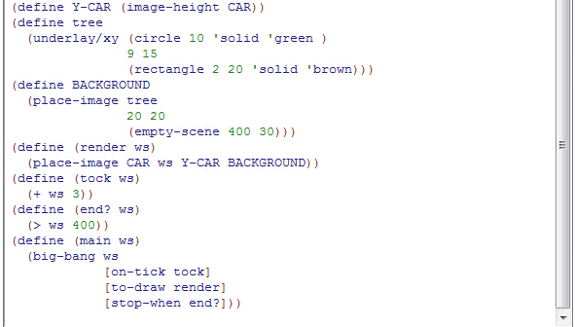

Slide 36
Exercise 38
Modify the interpretation of the sample data definition so that a state denotes the x coordinate of the right-most edge of the car.

Slide 37


Slide 38
Sample problem
Design a program that moves a car across the world canvas, from left to right, at the rate of three pixels per clock tick. If the mouse is clicked anywhere on the canvas, the car is placed at that point.

Slide 39
Step 1
There are no new properties, meaning we do not need new physical or graphical constants.

Slide 40
Step 2
Since the program is still concerned with only one property that changes over time—the location of the car—the existing data representation suffices.

Slide 41
Step 3
The problem statement now explicitly calls for a mouse event handler, without giving up on the clock-based movement of the car.
If the mouse event is “button-down”, place the car at the position (x,y)
(define (hyper x-position-of-car x-mouse y-mouse me)
new-x-position-of-car)

Slide 42
Step 3
(define (hyper x-position-of-car x-mouse y-mouse me)
(cond
[(string=? “button down” me) x-mouse]
[else x-position-of-car]))

Slide 43
Step 4
Lastly, we need to modify our main function to take care of mouse events. All this requires is the addition of an on-mouse clause that defers to the new entry on our wish list:
(define (main ws)
(big-bang ws
[on-tick tock]
[on-mouse hyper]
[to-draw render]))

Slide 44
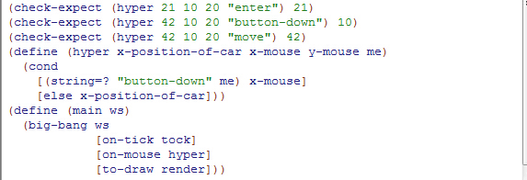

Slide 45
3.7 A Note on Mice and Characters

Slide 46
A mouse event recorder

Slide 47
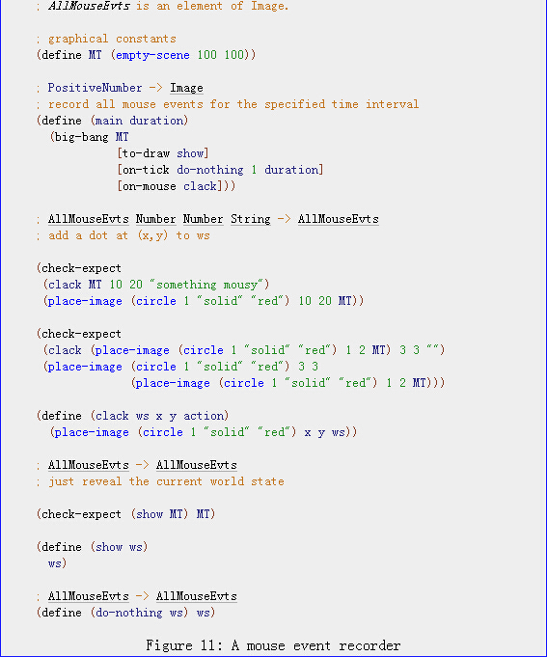

Slide 48
A key event recorder

Slide 49
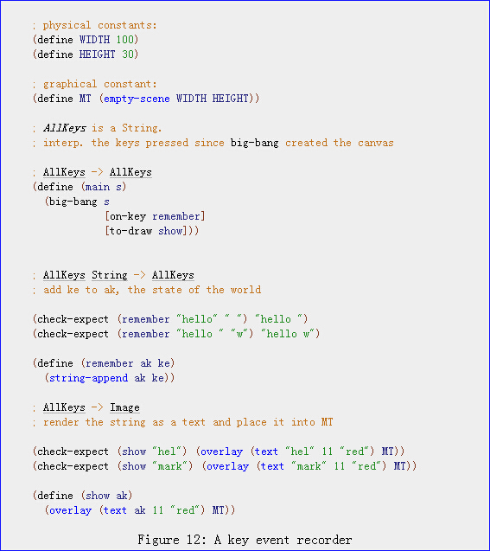

Slide 50
Exercise 41
Look up the "2htdp/image" teachpack and find a way to create framed, left-aligned text. Then change the program in figure 12 so that it uses this combination of image primitives to render its state.
(frame (ellipse 40 40 "solid" "gray"))

Slide 51
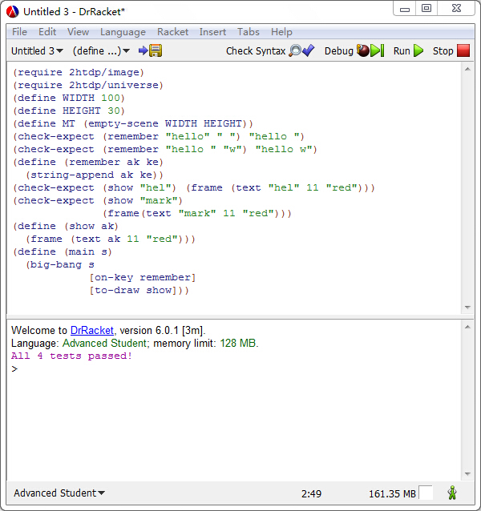

Slide 52
Exercise 42
Run the main function again, press some regular keys on your keyboard, and then try the tab key or the delete—also known as rubout—key. The result of these actions is an application of the key event handlers to strings such as "\t" and "\r". Appearances are deceiving, however. These strings consists of a single character and remember therefore adds them to the end of the current world state. Read the documentation of on-key to find out which strings belong to KeyEvent; then use a cond expression inside of remember so that it ignores all key strokes represented by one-character strings.

Slide 53
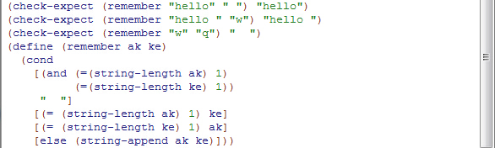

Slide 54
3.8 Virtual Pet Worlds
This exercise section introduces the first two elements of a virtual pet game. It starts with just a display of a cat that keeps walking across the screen. Of course, all the walking makes the cat unhappy and its unhappiness shows. Like all pets, you can try petting, which helps some, or you can try feeding, which helps a lot more.

Slide 55

3.8 Virtual Pet Worlds
First, we need a cat

Slide 56
Exercise 43
Design a “virtual cat” world program that continuously moves the cat from left to right for a specified time period. Make the cat move three pixels per clock tick. Whenever the cat disappears on the right it should re-appear on the left. You may wish to read up on the modulo function.
(modulo x y) → integer
x : integer y : integer
Finds the remainder of the division of the first number by the second:
> (modulo 9 2) 1
> (modulo 3 -4) -1

Slide 57
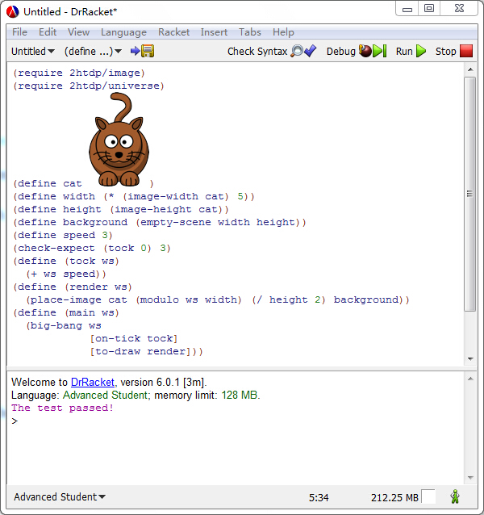

Slide 58

Exercise 44
Improve the cat animation with a second, slightly different image:
Adjust the rendering function so that it uses one cat image or the other based on whether x coordinate is odd. Read up on odd? in the help desk, and use a cond expression to select cat images.
(odd? x) → boolean?
x : integer

Slide 59
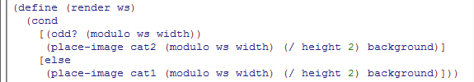

Slide 60
Exercise 45
Design a world program that maintains and displays a “happiness gauge” over some specified period of time. With each clock tick, happiness decreases by -0.1, starting with 100, the maximum score; it never falls below 0, the minimum happiness score. Every time the down arrow key is pressed, happiness increases by 1/5; every time the up arrow is pressed, happiness jumps by 1/3.

Slide 61
Exercise 45
To show the level of happiness, we use a scene with a solid, red rectangle with a black frame. For a happiness level of 0, the red bar should be gone; for a happiness level of 100, the bar should go all the way across the scene.

Slide 62
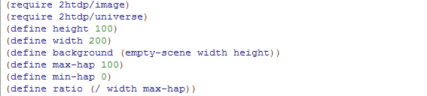

Slide 63
